Slide 1
TRAFFIC TELLIGENCE
Presented by
Gudi Chandana (23BFA04L13) (Electronics and Communication Engineering)
Shaik Rajiya Begam (22BFA04321) (Electronics and Communication Engineering)

Slide 2
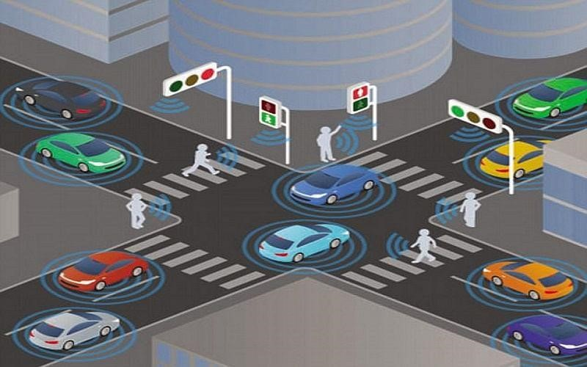
INTRODUCTION
TrafficTelligence is a machine learning-based system that predicts traffic volume using historical data, weather, and events.It helps reduce congestion and improve urban mobility through adaptive traffic control and signal optimization.City planners use it for smarter infrastructure design and public transit planning.Commuters and apps gain real-time insights for efficient route planning and congestion avoidance. Built with tools like NumPy, Pandas, Scikit-learn, XGBoost, and Flask, it offers a data-driven traffic solution.

Slide 3
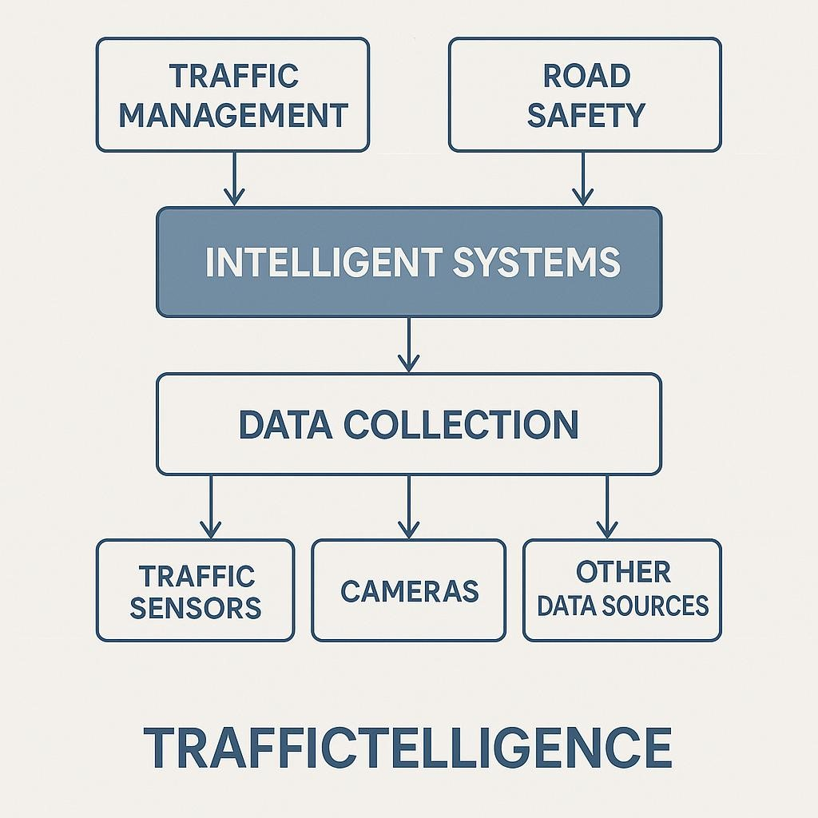
PURPOSE:
The purpose of TrafficTelligence is to leverage intelligent systems and real-time data to improve traffic management, enhance road safety, and reduce congestion in urban and semi-urban environments.
TrafficTelligence uses sensors, cameras, and data analytics to monitor traffic flow, vehicle count, speed, and violations in real time. This helps traffic authorities dynamically manage signal timings, detect anomalies, and optimize traffic movement.
By identifying accidents, congested zones, or unauthorized movements instantly, TrafficTelligence allows quicker response from emergency services and helps prevent further incidents.

Slide 4
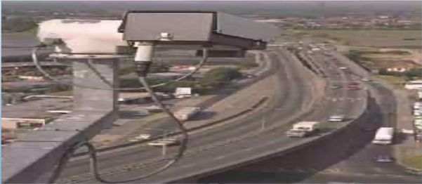
TRAFFIC MONITORING:
Traffic monitoring using AIML involves building chatbots that deliver traffic updates and alerts through natural language conversations. These bots use rule-based patterns to understand and respond to user queries about road conditions and routes. They can connect with real-time data sources like GPS and traffic APIs to provide current information. While AIML lacks advanced AI capabilities, it serves as a simple interface for sharing traffic data. Users can ask questions like “Is there traffic on the highway?” and get instant responses. This approach makes traffic information more accessible through chat platforms. It’s useful for basic route planning and congestion alerts.

Slide 5
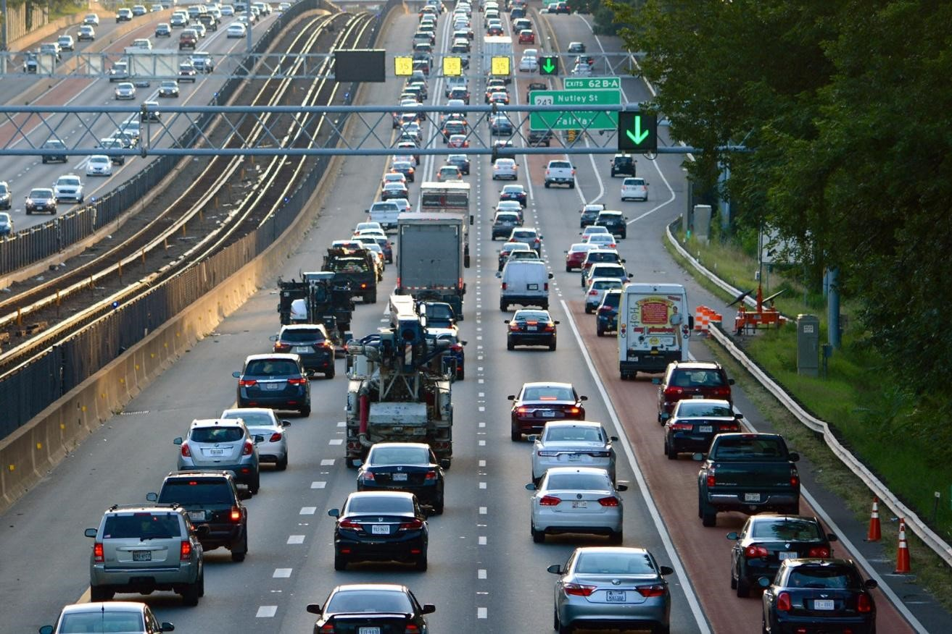
PROBLEM STATEMENT:
Urban areas today face increasing challenges with traffic congestion, delayed emergency response, inefficient signal control, and frequent road accidents. Traditional traffic management systems lack the real-time adaptability and data-driven intelligence needed to respond effectively to dynamic traffic conditions. There is a critical need for a smart, automated system that can monitor, analyze, and manage traffic flow in real time while improving road safety, minimizing delays, and supporting sustainable urban mobility. Traditional systems fail to provide real-time adaptability, leading to frustration, longer commute times, and increased road accidents.

Slide 6
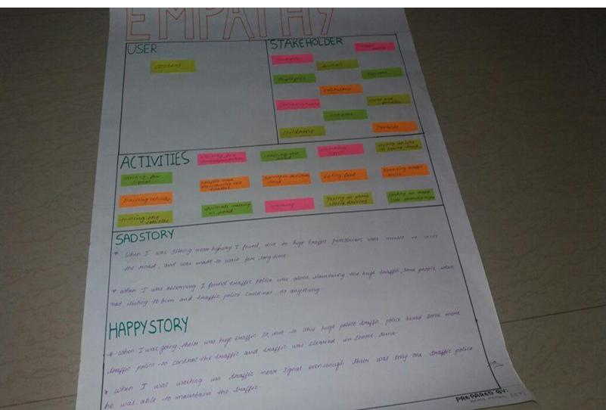
MAP CANVAS:
Empathy is the experience of understanding another person’s condition from their prospective.
Empathy mapping canvas is described as user, stakeholders and activities involved in my projects.
The empathized mode is the work to understand people, within the context of our design challenges.

Slide 7
Activities:
Real-Time Traffic Monitoring
Data Collection & Analysis:
Incident Detection & Alerting
Predictive Modeling
Traffic Signal Optimization
Public Information Sharing
Post-Event Analysis

Slide 8
APPLICATIONS:
Traffic intelligence using AIML (Artificial Intelligence Markup Language) enables the development of conversational chatbots that assist with traffic management and user guidance. These applications include providing real-time traffic updates, congestion alerts, route suggestions, and incident notifications through natural language interactions. By integrating AIML chatbots with traffic data APIs or GPS systems, users can ask questions like “What’s the traffic like on Main Street?” or “Suggest an alternate route to the airport,” receiving instant, context-aware responses. Such systems enhance public accessibility to traffic information via messaging platforms, mobile apps, or voice assistants. While AIML-based systems are rule-driven and lack advanced machine learning capabilities, they serve as lightweight, cost-effective solutions for disseminating traffic intelligence in a user-friendly manner.
Adaptive Traffic Signals
Accident Detection & Prediction
Route Optimization
Autonomous Vehicle Navigation
Smart Parking

Slide 9
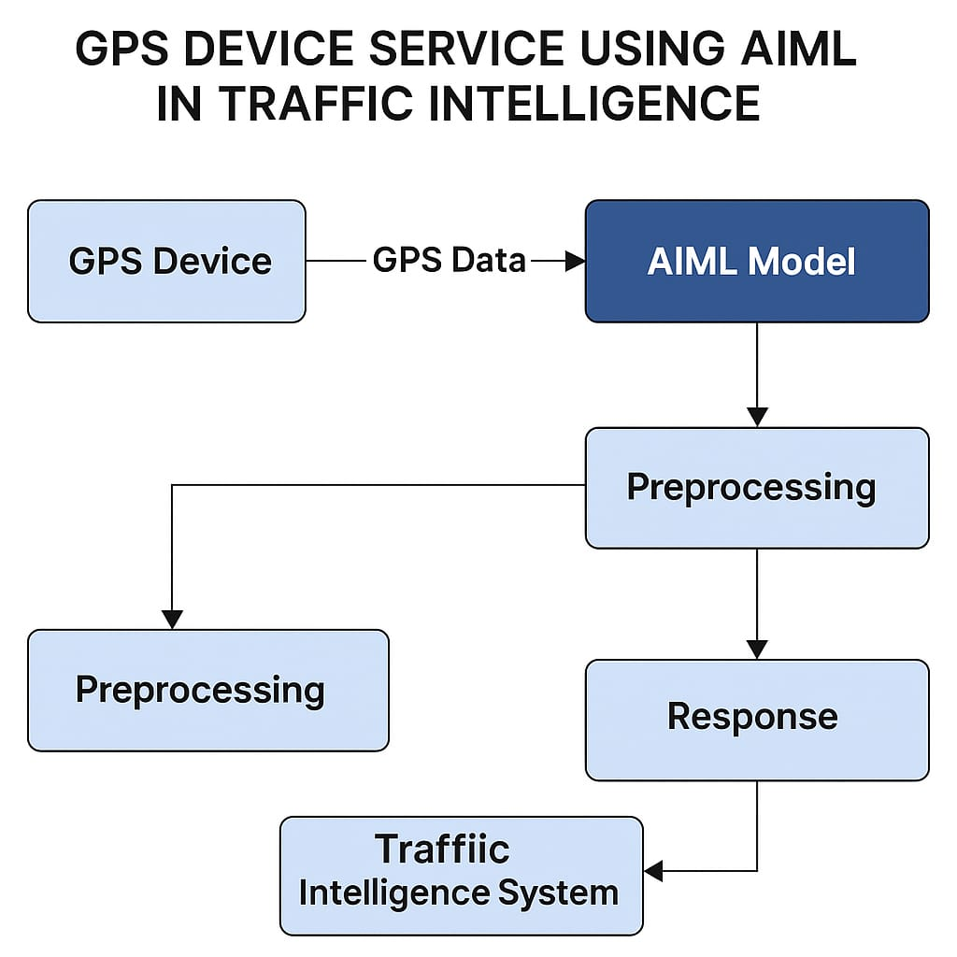
GPS Device Architecture:

Slide 10
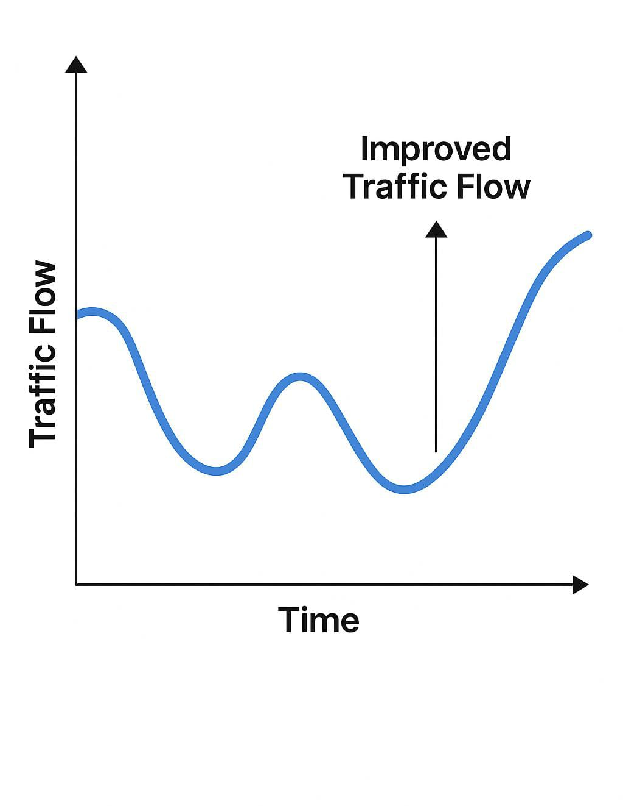
BENEFITS:
Traffic intelligence using AIML offers several benefits by making traffic information more accessible and user-friendly. It enables real-time communication of traffic conditions through conversational interfaces like chatbots and voice assistants. Users can get instant updates on congestion, accidents, or road closures by simply asking questions in natural language. This technology reduces the need for complex user interfaces, allowing people to interact using familiar messaging platforms. AIML-based systems are cost-effective and easy to integrate with existing traffic data sources such as GPS and traffic APIs. They also support 24/7 automated responses, improving efficiency in traffic management communication. Overall, it enhances public engagement and decision-making by delivering timely, personalized traffic insights.

Slide 11
CHALLENGES:
Challenges in traffic intelligence using AIML include its limited ability to process and interpret real-time, dynamic data such as live video feeds or complex traffic patterns. Since AIML relies on predefined rules and pattern matching, it lacks the advanced learning capabilities needed for accurate predictive analysis or adaptive responses. Integrating AIML chatbots with real-time traffic systems can be complex and may result in delays or inaccuracies in information delivery. Additionally, handling a wide variety of user queries with natural language variations remains difficult without extensive scripting. Scalability is also an issue when dealing with large volumes of traffic data or high user demand. These limitations make AIML less effective for sophisticated traffic management tasks that require deep learning or real-time decision-making. However, with proper integration and optimization, some of these challenges can be mitigated. Scalability is another issue when dealing with high volumes of data or large numbers of simultaneous user requests. AIML chatbots also struggle with understanding context and maintaining conversation flow over multiple interactions.
Data Privacy
High Infrastructure Cost
Model Accuracy and Bias
Real-Time Performance

Slide 12
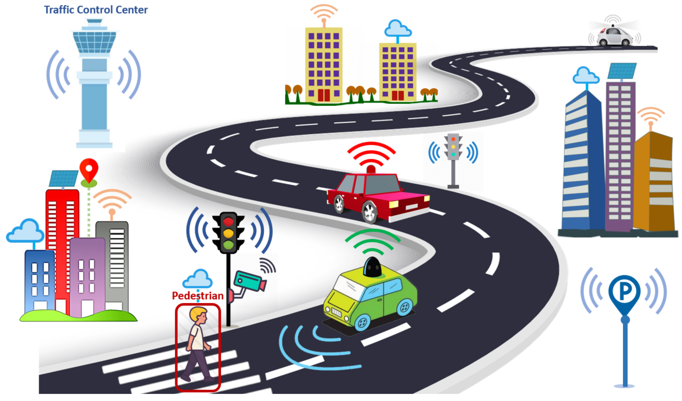
FUTURE TRENDS:
Integration with 5G
AI-Driven City Planning
Edge AI for faster local decisions
Vehicle-to-Infrastructure Communication

Slide 13
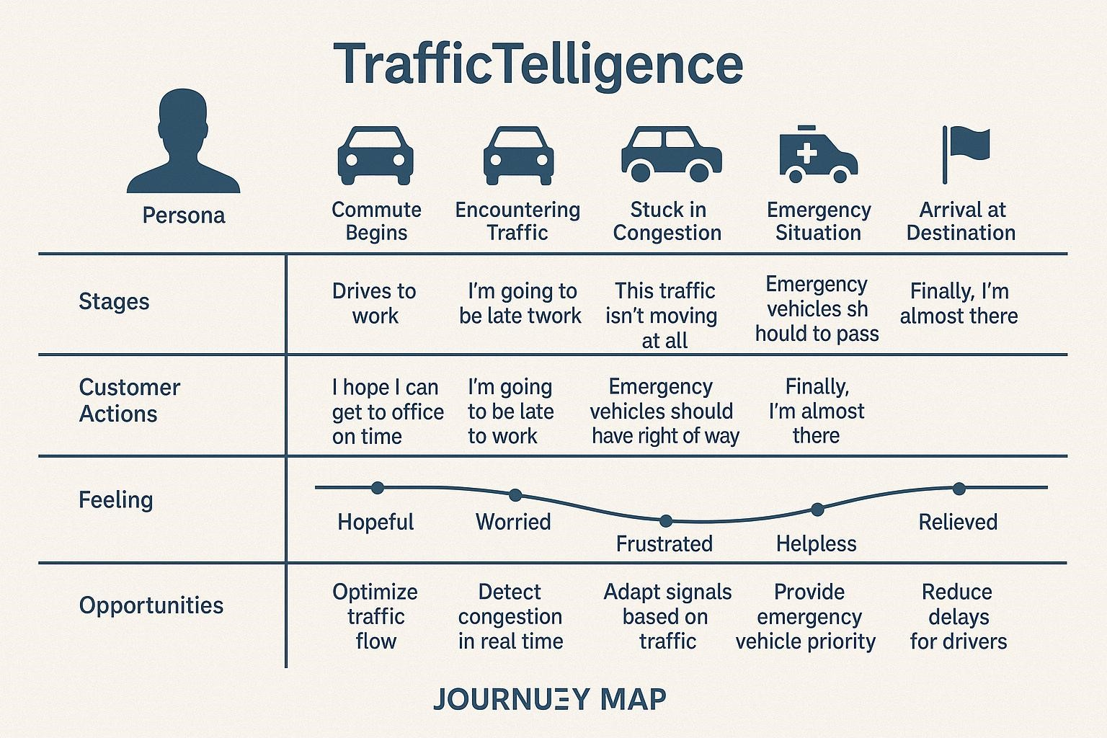
CUSTOMER JOURNEY MAP:

Slide 14
REQUIREMENT ANALYSIS:
Collect real-time GPS data from vehicles
Transmit data via 4G/5G/Wi-Fi networks
Store and manage large-scale traffic datasets
Predict traffic flow and congestion using ML models
Detect traffic anomalies and incidents
Provide alternate route recommendations
Display live traffic maps and analytics dashboards
Send alerts to users and traffic authorities.
Users continue to use the traffic intelligence tool, recommend it to others, or upgrade their services
Users provide feedback on their experience, report issues, or suggest improvements.
Users actively use the traffic intelligence tool to navigate, receive updates, and analyze traffic data.
A Customer Journey Map for Traffic Intelligence outlines the steps a user takes while interacting with traffic management systems or services
It visualizes the user's experience, highlighting their needs, emotions, and pain points at each stage of their journey.

Slide 15
CONCLUSION :
The advent of AI and Machine Learning has ushered in a new era for traffic intelligence, fundamentally transforming how we perceive, analyze, and manage urban mobility. This sophisticated integration allows for the processing and interpretation of immense volumes of data, far beyond human capacity. By drawing upon real-time sensor data from cameras, inductive loops, GPS devices, and even connected vehicles, coupled with historical traffic patterns, weather conditions, special events, and urban development plans, AI/ML models can construct a remarkably comprehensive and dynamic understanding of the traffic ecosystem.The core strength lies in their ability to identify intricate patterns and anomalies that would otherwise go unnoticed. Predictive analytics, powered by deep learning and reinforcement learning algorithms, can forecast traffic congestion with unprecedented accuracy, often hours in advance. This foresight enables proactive interventions, such as dynamic rerouting suggestions, optimized traffic signal timings that adapt to real-time flow, and the intelligent deployment of emergency services.

Slide 16
**THANK YOU**

